Slide 1

Noise-induced Hearing Loss – An investigation
Course Facilitator: Marcos Bittencourt
By: Vinod Vijayaraghavan
Shivam Rana
Tarunjot Singh

Slide 2
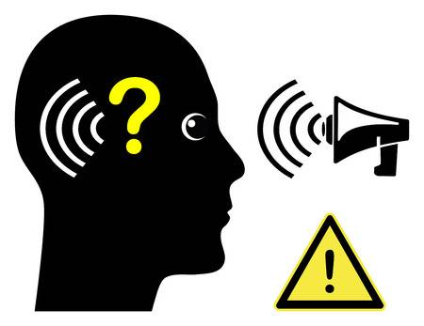
Overview
Noise is a serious and widespread problem in many workplaces. Over time, loud noise from machinery, processes, and equipment can cause permanent hearing loss in employees. Are we doing enough to stop this?
Of all occupational diseases, noise induced hearing loss (NIHL) accounts for the highest number of accepted occupational disease.
By working together to control noise exposure, employers and employees can prevent occupational hearing loss.

Slide 3
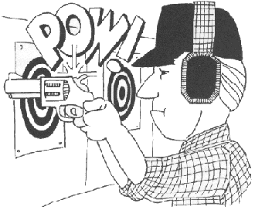
Who are affected the most?
Top 10 Noisiest jobs, Activities and Workplaces

Slide 4
Combined visualisation abstraction

Slide 5
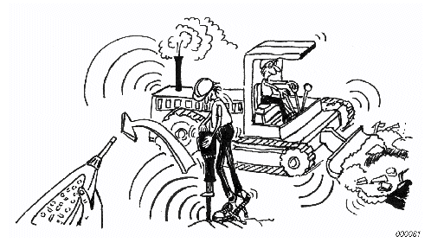
Findings
More than 36% of workers are working in very noisy environments
Only 54% of workers are using Hearing protection
More than 51% users are exposed to ototoxic chemicals
More than 58% of workers are exposed to Continuous noise

Slide 6
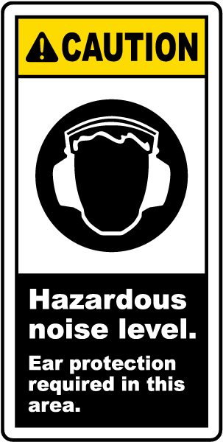
Conclusion & Recommendations
It is obvious from the analysis that Employers nor Employees are taking enough measures to prevent NIHL. This needs to be changed!
Following list of suggestions can help employers & employees to reduce noise exposures in the workplace:
Employers
Make noise control a component of your health and safety program.
Train workers on the health hazards of noise and how to use controls.
Purchase or rent quiet equipment and tools, and use noise mufflers.
Employees
Use hearing protection properly, even for short duration tasks.
Follow the manufacturer’s instructions on proper use and care of hearing protectors.
Participate in the employer’s hearing conservation program including periodic hearing tests and training programs on noise hazards.

Slide 7

Summary & Call to Action
The data used for Analysis and visualizations are from The National Institute for Occupational Safety and Health (NIOSH)
https://www.cdc.gov/niosh/data/datasets/RD-1005-2014-0/
The objective of this presentation is to spread awareness about NIHL

